Slide 1
DSAC: Hacking your way to being a data scientist
Bharat Desai

Slide 2
Worshop Pre-Reading and Downloads
ISLR Chapters 2,3,4,6 and 10
R, Python Language, Jupyter Notebook Installed

Slide 3
Todays Schedule
Aspects to Data Science
Data mining workflow
Data Scraping
Data Visualisation + Exploration
LUNCH BREAK
Bias and variance
What is supervised/Unsupervised/Semi-Supervised Learning
Regression
Classification
Cross Validation and Evaluating Prediction

Slide 4
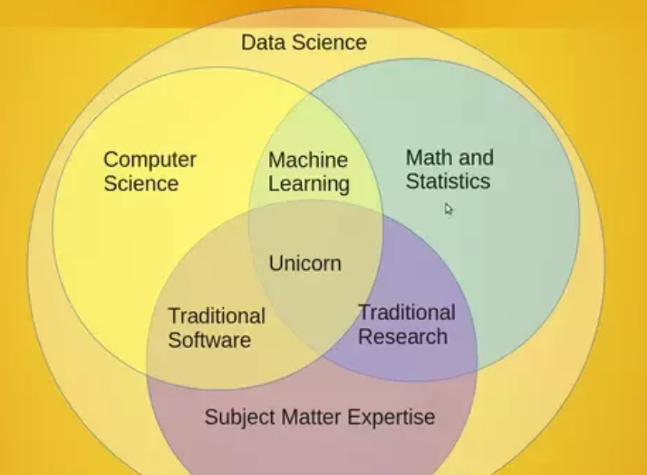
What is Data Science

Slide 5
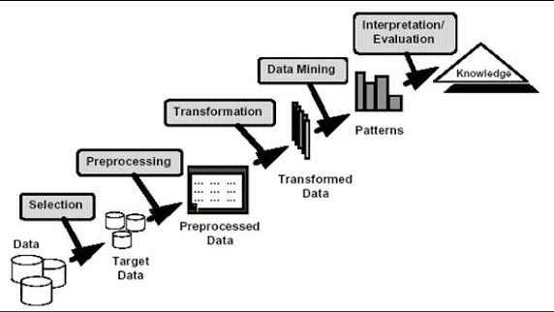
Data mining process flow

Slide 6
Types of data
Visual (Images/Videos)
Audio (.mp3/.wav)
Text (Speech Transcripts/Handwritten text/Blogs)

Slide 7
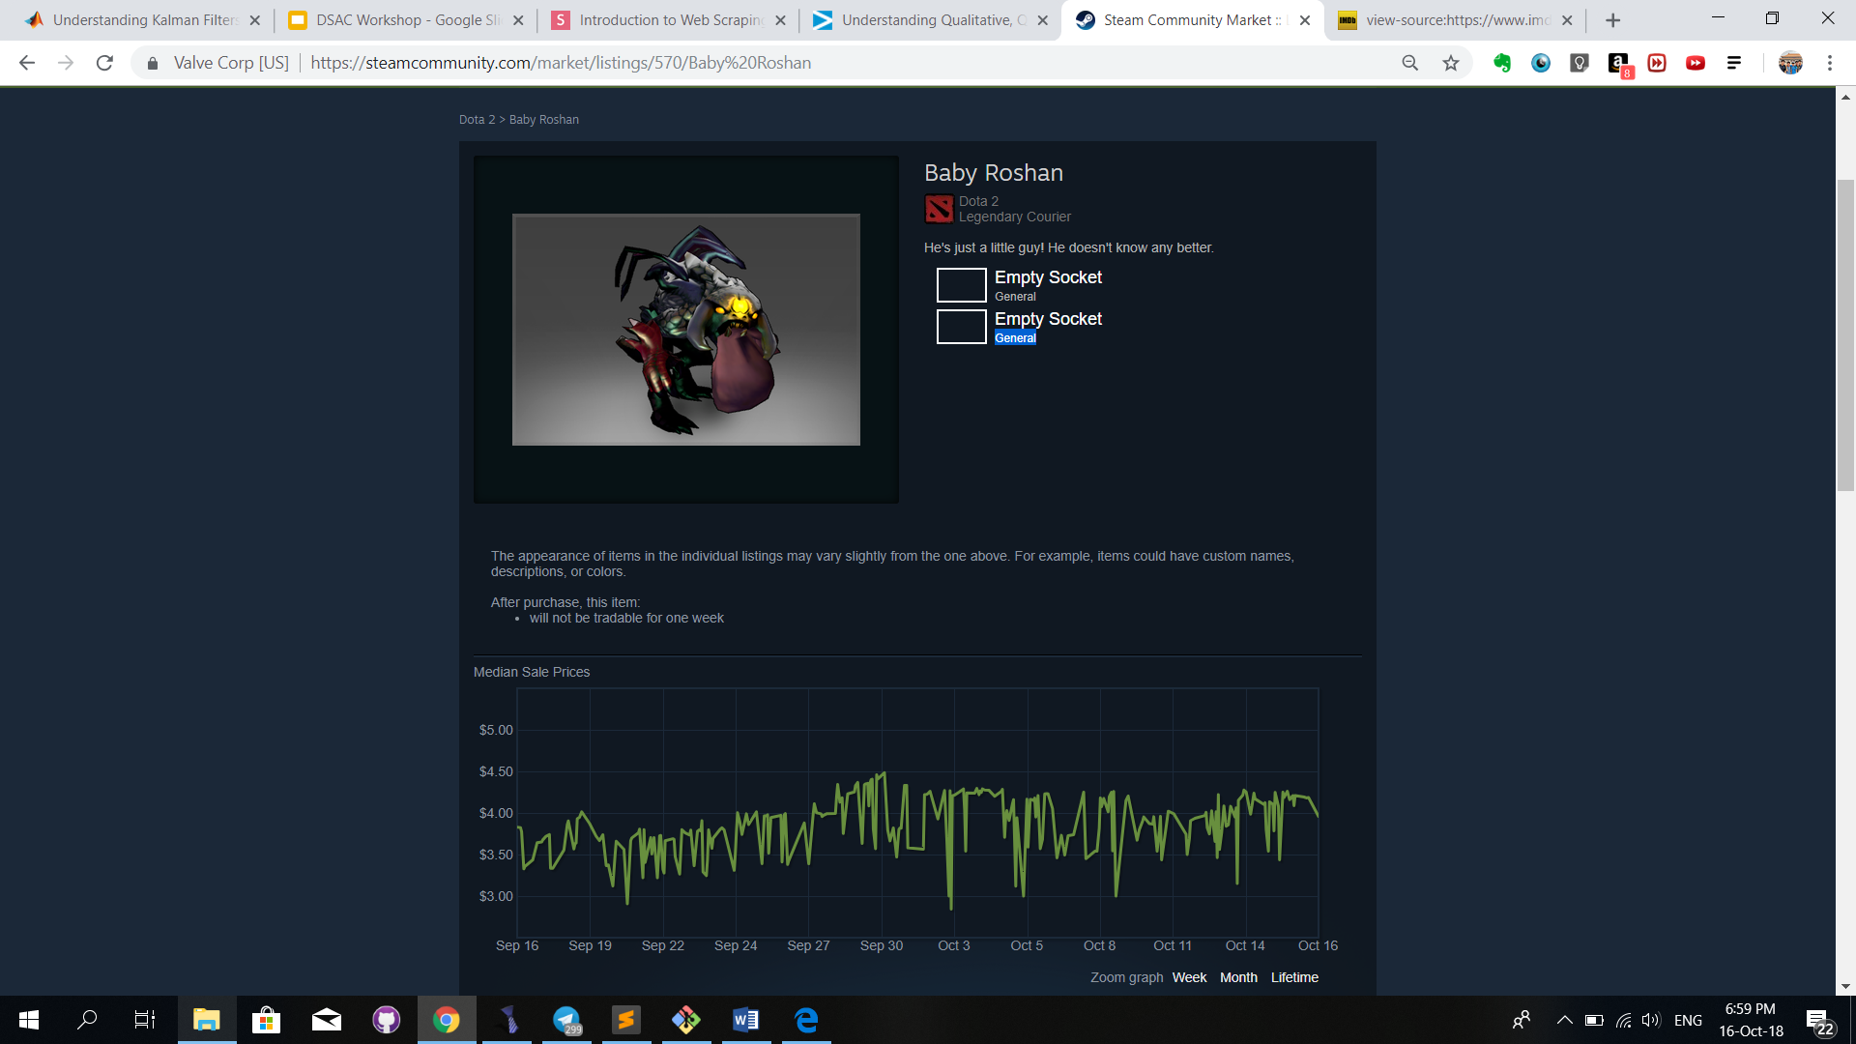
What you think you see
https://steamcommunity.com/market/listings/570/Baby%20Roshan

Slide 8
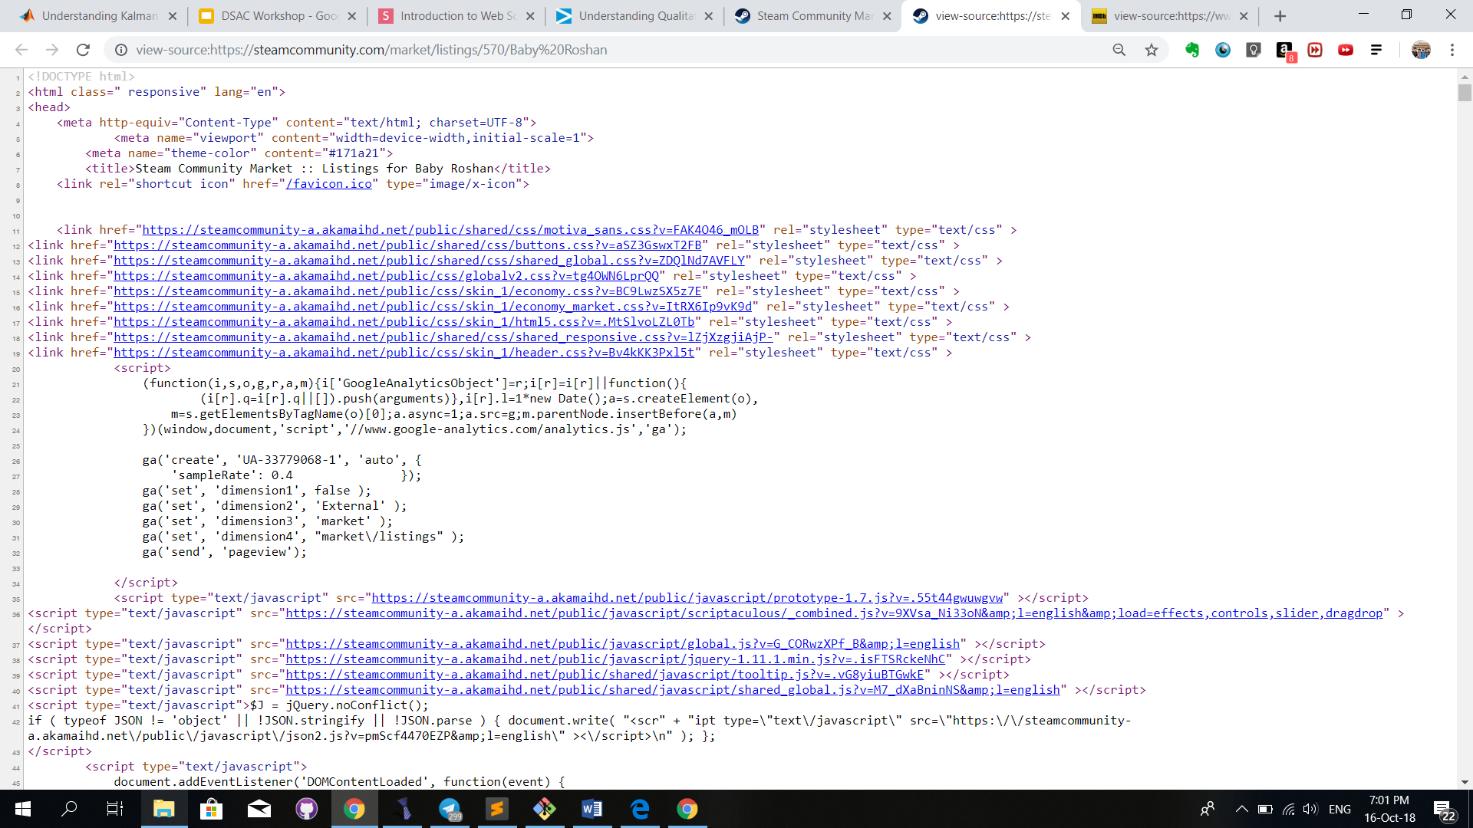
What you are actually seeing

Slide 9
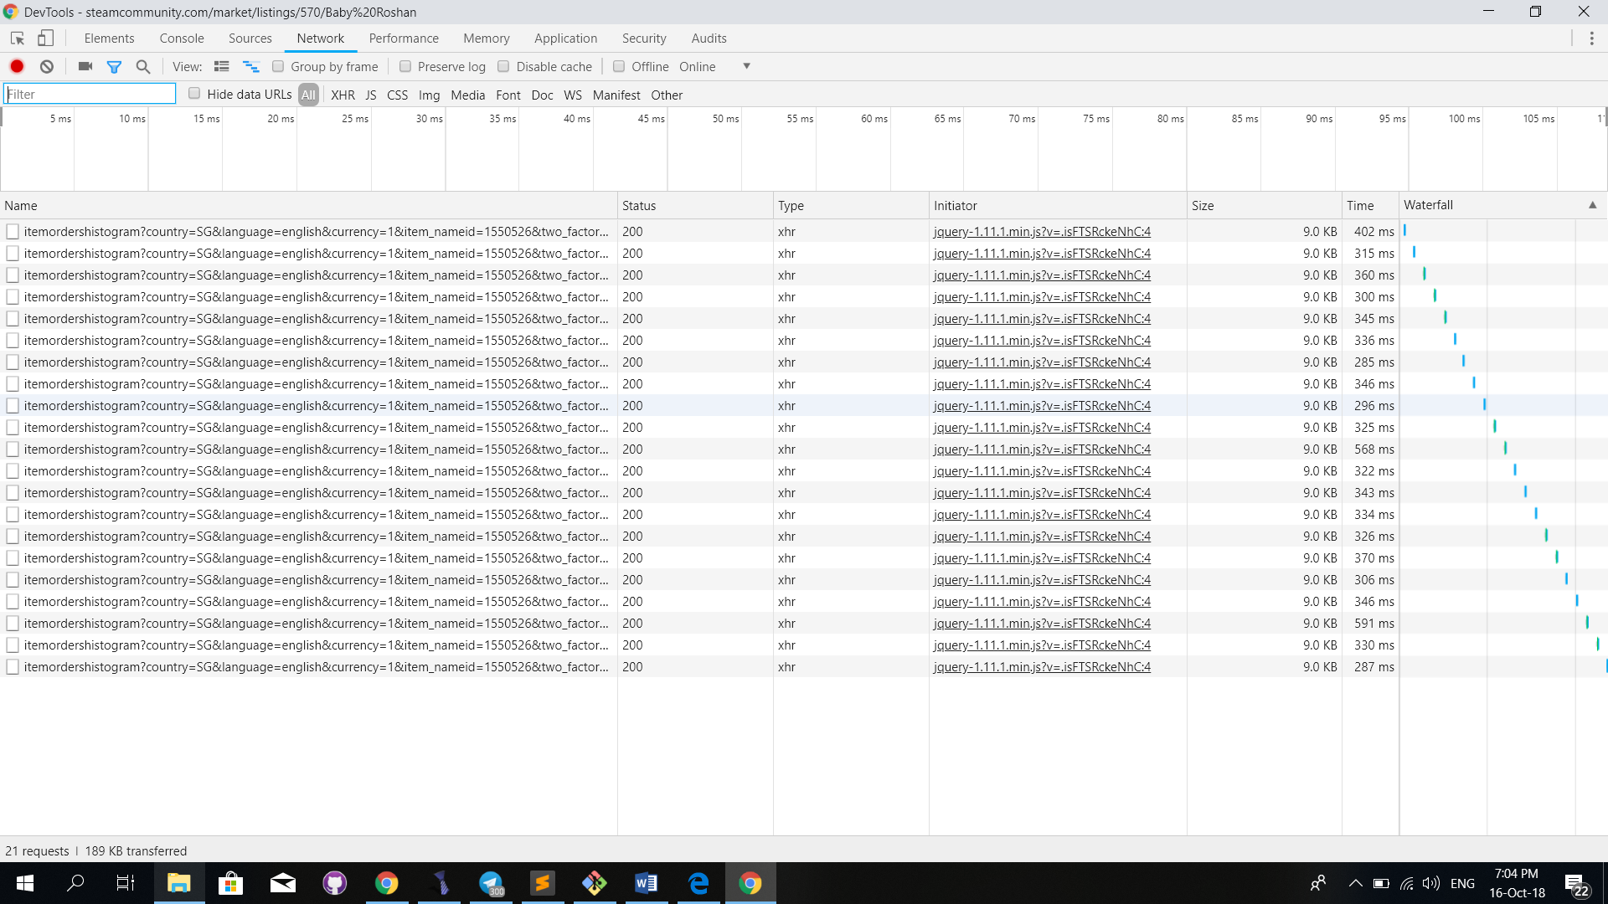
What is actually happening

Slide 10
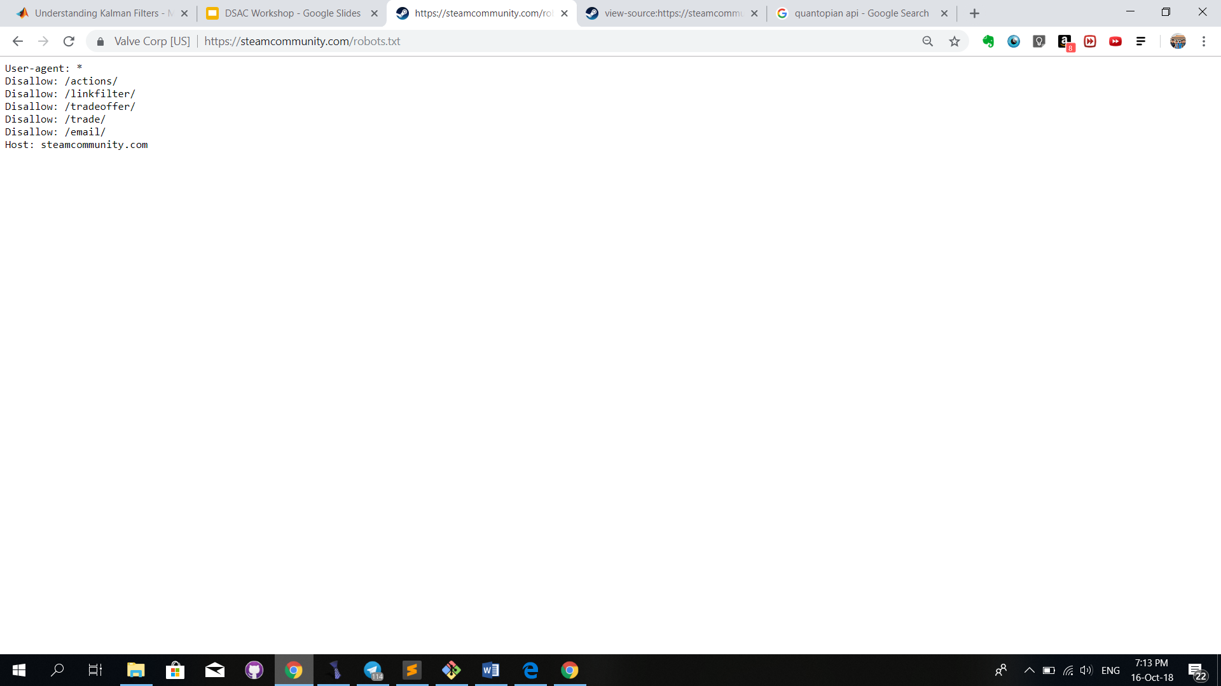
The laws of the internet

Slide 11
Exercise 1: Scraping historical price data
Objective: Output a csv file with the historical price data for the item ‘Frozen Baby Roshan’

Slide 12
You did it the hard way.
Very often, web services provide API’s.
If you sign up for an account with them you can obtain a license (free) to make requests for their data.
For each project you require the web services data, you can sign up for a api key, which will be used to identify your account when you make requests.
Free accounts usually have limitations on how many calls/requests you can make to retrieve the services data.

Slide 13
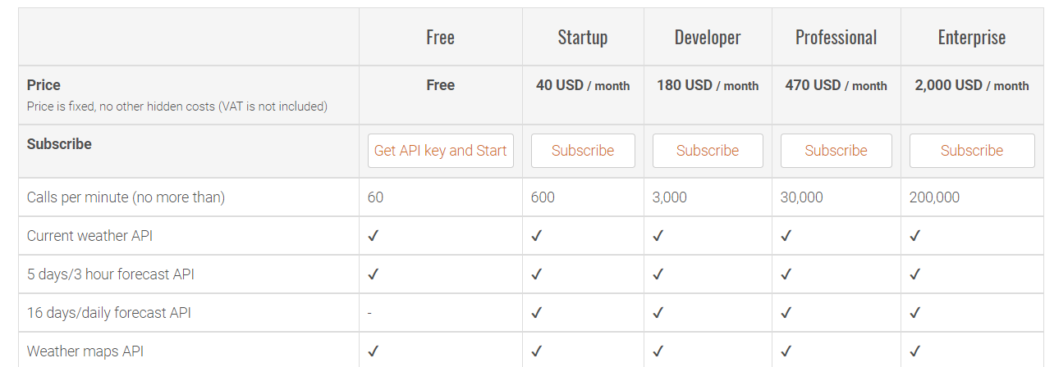
OpenWeatherMap Api (why you should never share your api key)

Slide 14
Data Visualization
Bcuz if you dont wanna be a data scientist….
You could just be a data ArTiST

Slide 15
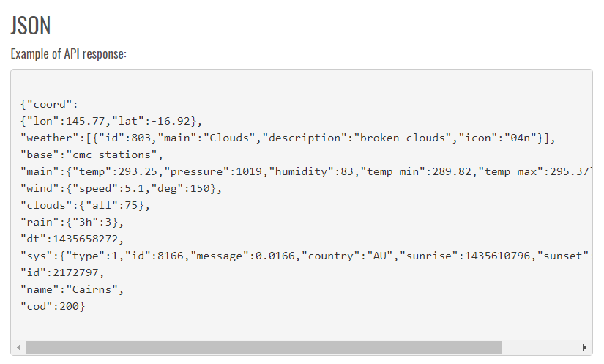
Sample of a response

Slide 16
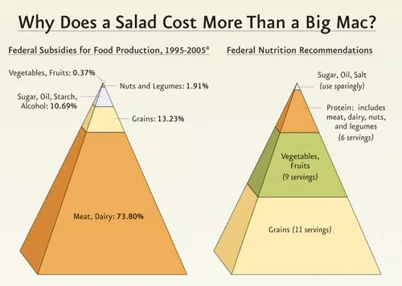

Slide 17
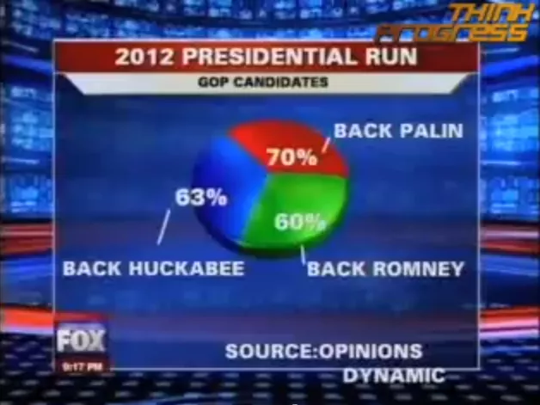

Slide 18
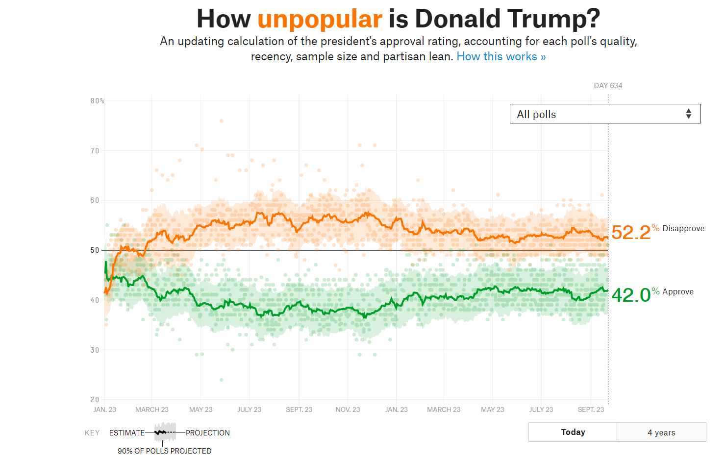
Data Visualization
https://projects.fivethirtyeight.com

Slide 19
Grammar of graphics
“What is a graphic? How can we succinctly describe a graphic? And how can we create the graphic that we have described? These are important questions for the field of statistical graphics. One way to answer these questions is to develop a grammar: “the fundamental principles or rules of an art or science”
-Hadley Wickham, A layered grammar of graphics
https://byrneslab.net/classes/biol607/readings/wickham_layered-grammar.pdf

Slide 20
Exercise 2
Go through the lab exercise

Slide 21
Machine learning models in Data mining

Slide 22
Data mining process flow

Slide 23
Building models from raw data
What is machine learning?
Why do we utilize learning?
What are the types of models we can build?
What kind of questions can we answer with these models?

Slide 24
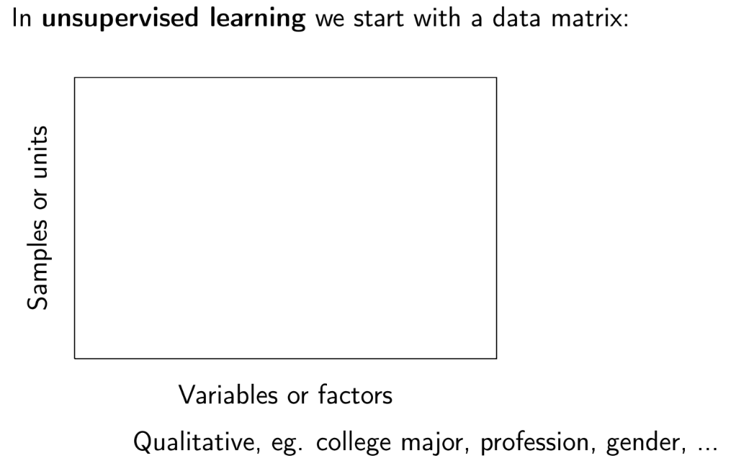

Slide 25
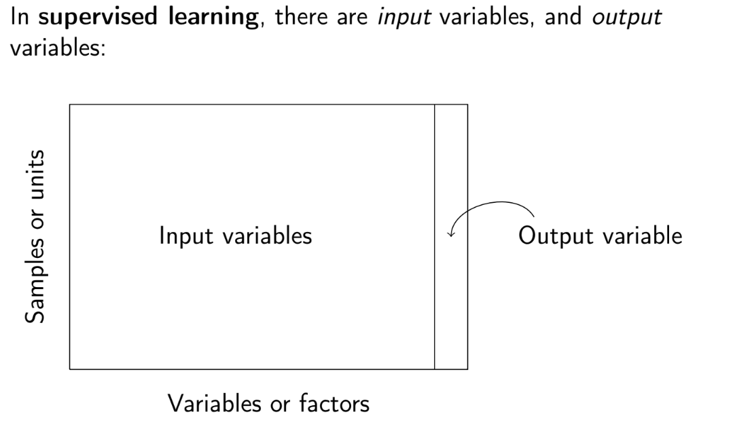

Slide 26
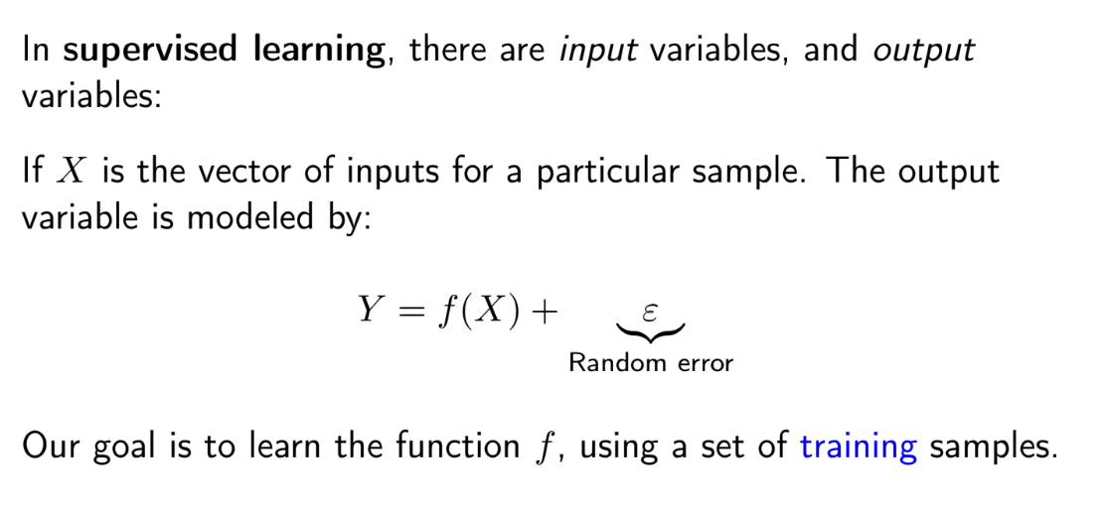

Slide 27
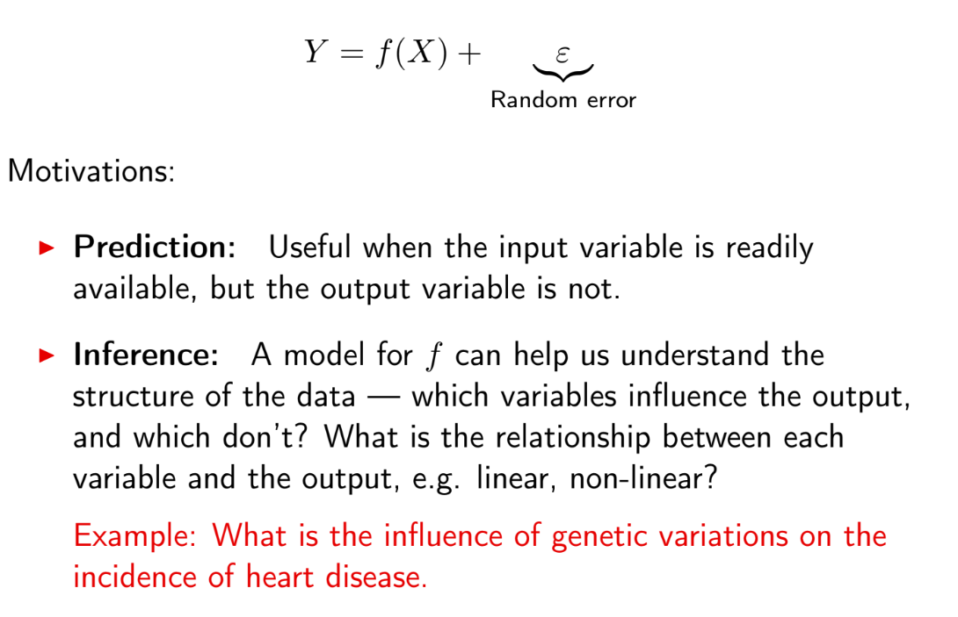

Slide 28
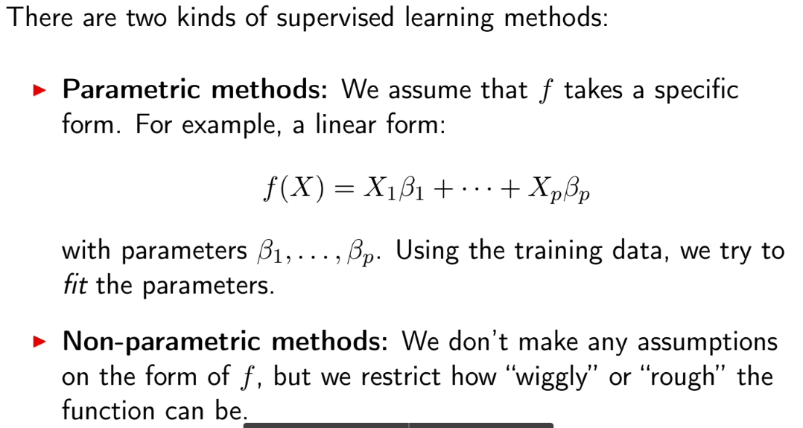
Parametric and non parametric models

Slide 29
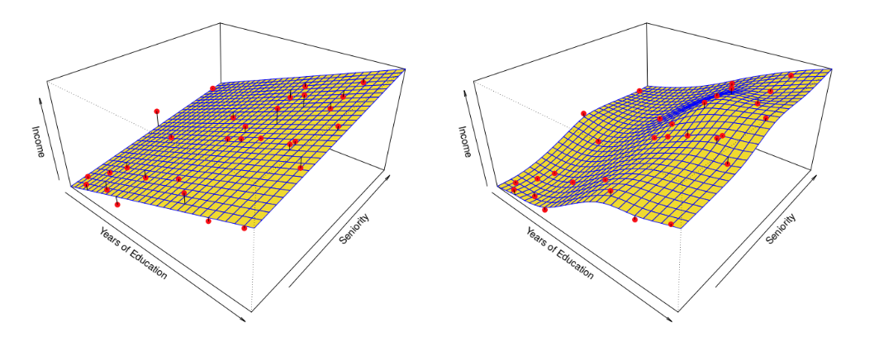
Parametric and non-parametric methods

Slide 30
Parametric and non-parametric methods
Parametric methods have a limit of fit quality. Non-parametric
methods keep improving as we add more data to fit.
Parametric methods are often simpler to interpret.

Slide 31
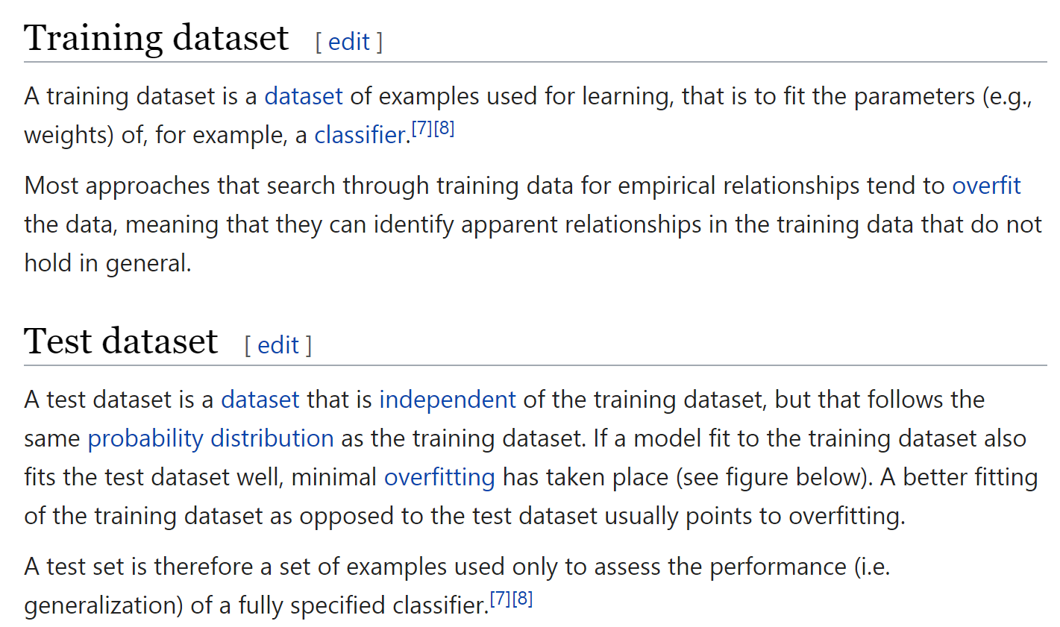
Training and Test Data

Slide 32
Training and Test Data

Slide 33
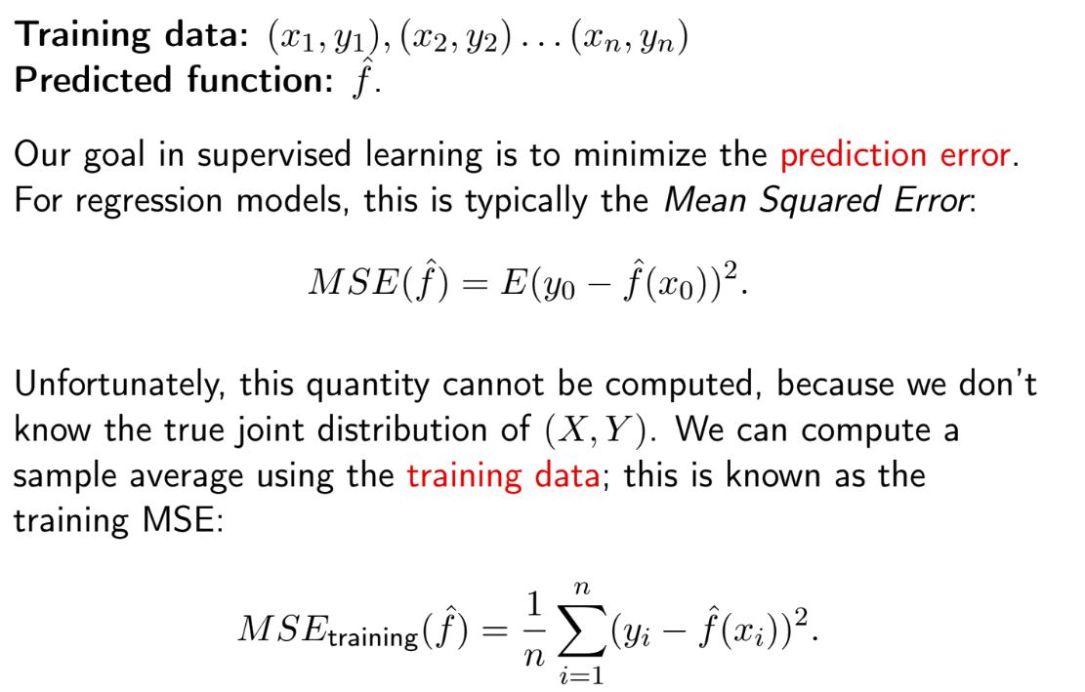

Slide 34
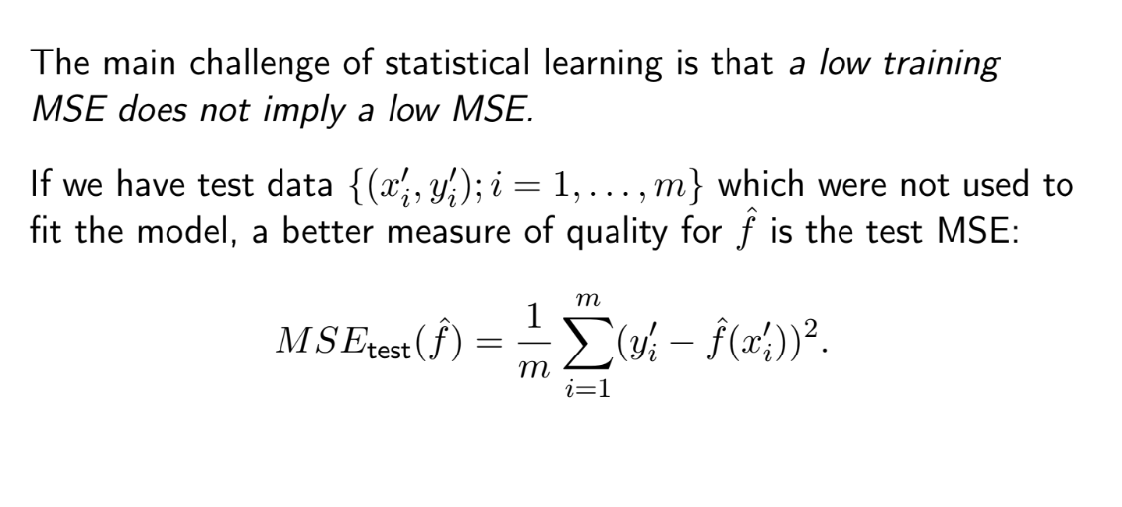

Slide 35
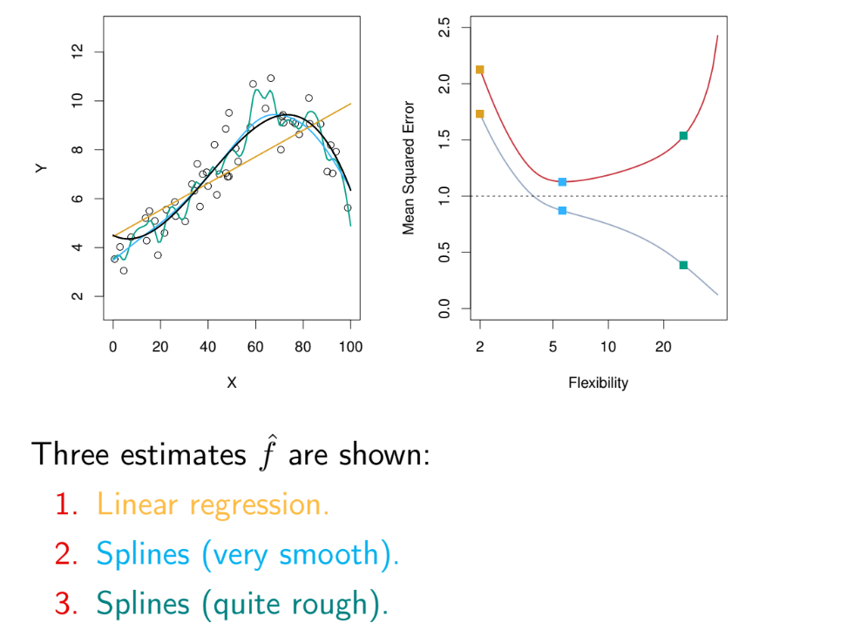

Slide 36
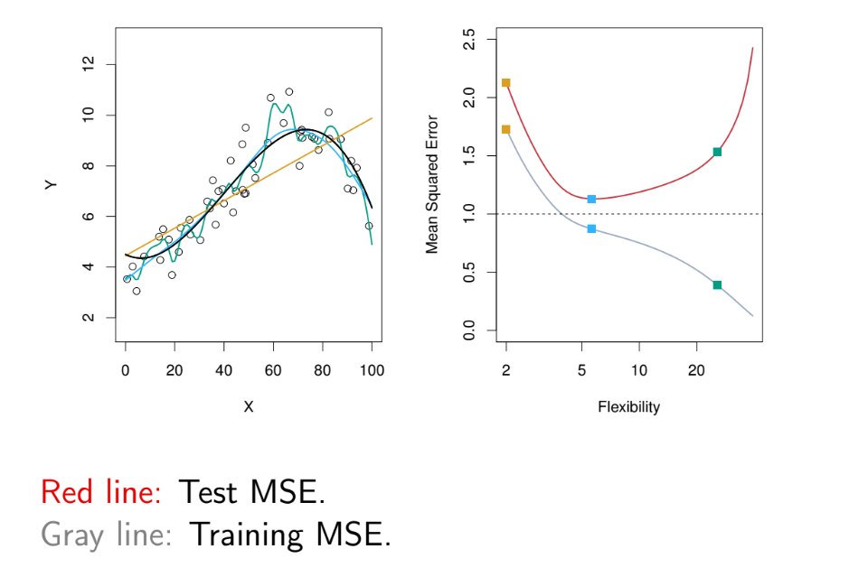

Slide 37
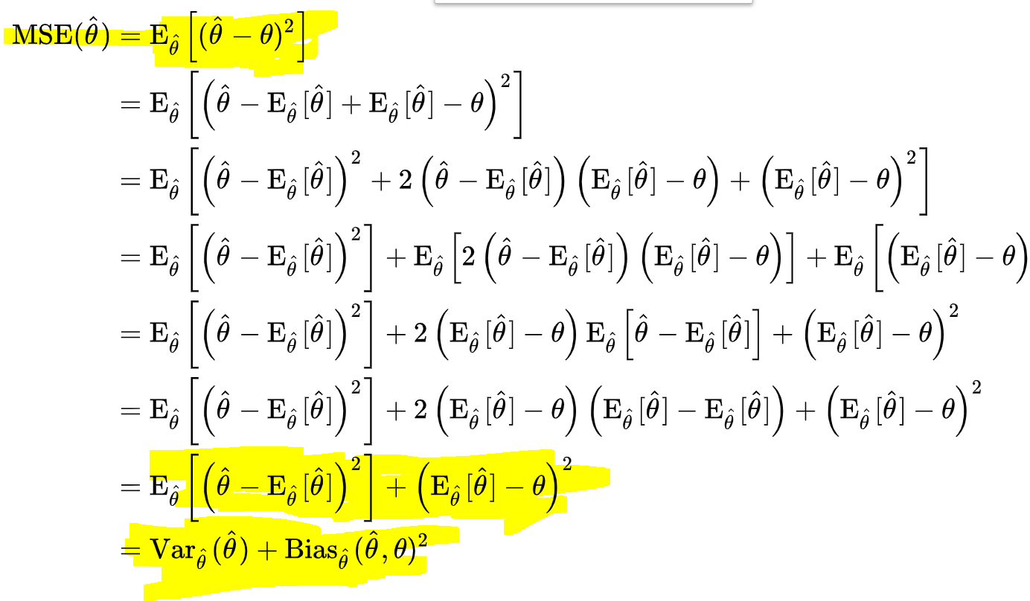

Slide 38
Finding the balance
Bias is the difference between the average prediction of our model and the correct value which we are trying to predict. Model with high bias pays very little attention to the training data and oversimplifies the model. It always leads to high error on training and test data.
Variance is the variability of model prediction for a given data point or a value which tells us spread of our data. Model with high variance pays a lot of attention to training data and does not generalize on the data which it hasn’t seen before. As a result, such models perform very well on training data but has high error rates on test data.
The bias–variance tradeoff is the property of a set of predictive models whereby models with a lower bias in parameter estimation have a higher variance of the parameter estimates across samples, and vice versa.

Slide 39
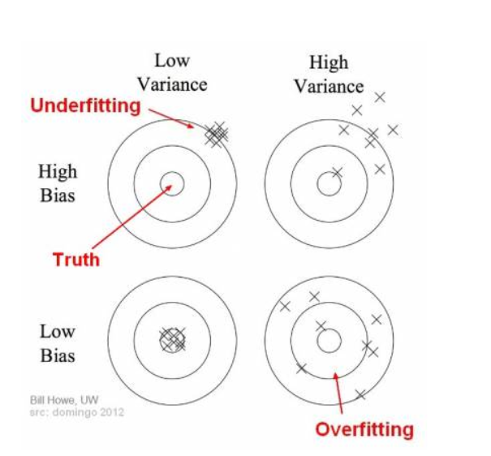

Slide 40
REGRESSION

Slide 41
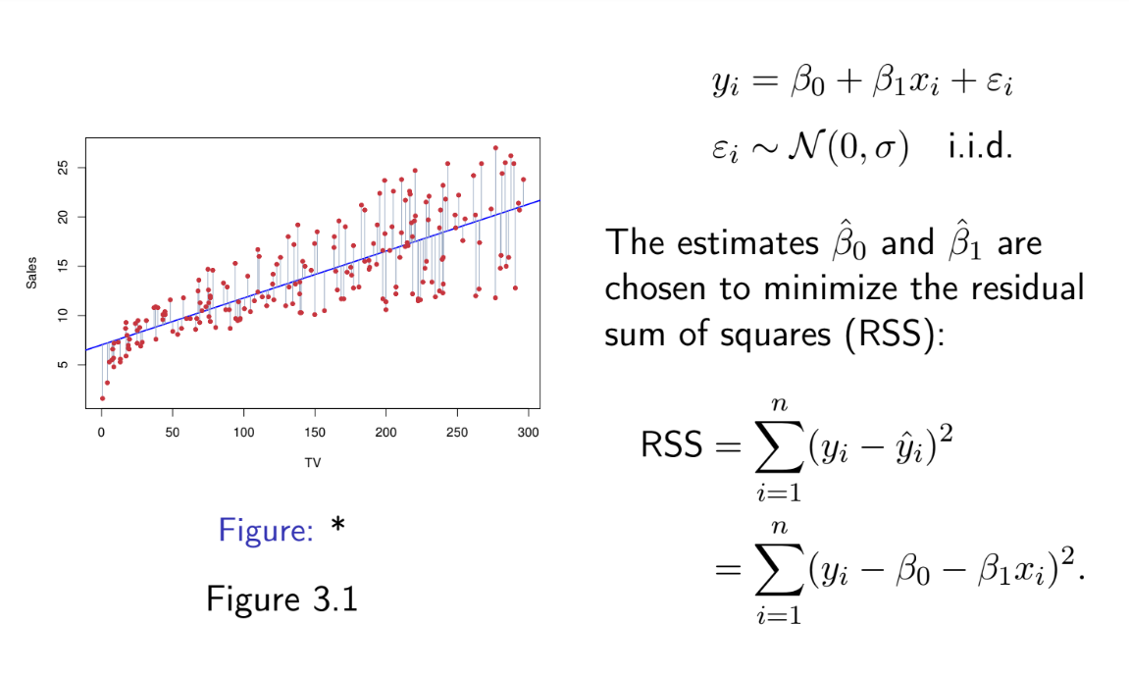

Slide 42
Which Variables are important?
Null Hypothesis: Beta coefficient =0
Alternative Hypothesis: Beta Coefficient !=0
The t-statistic associated to the ith predictor is the square root of the F-statistic for the null hypothesis which sets only βi = 0.

Slide 43
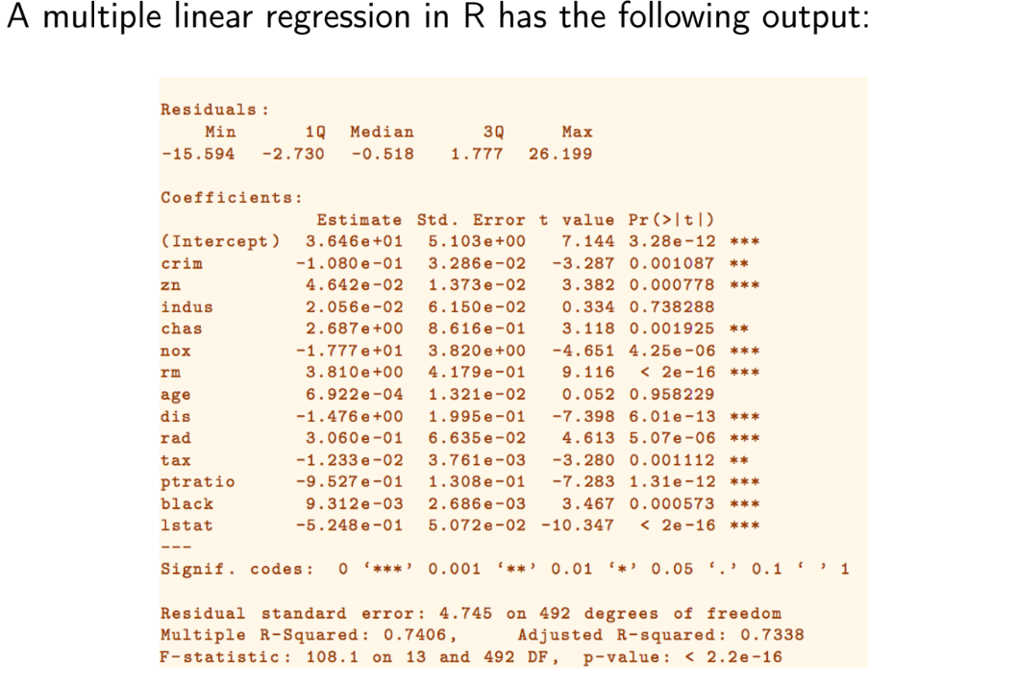

Slide 44
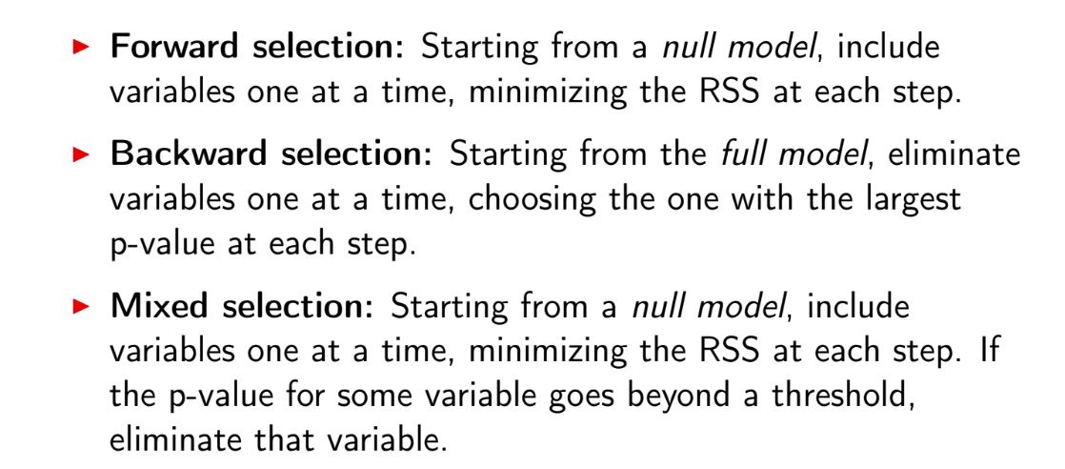
How many Variables are important?

Slide 45
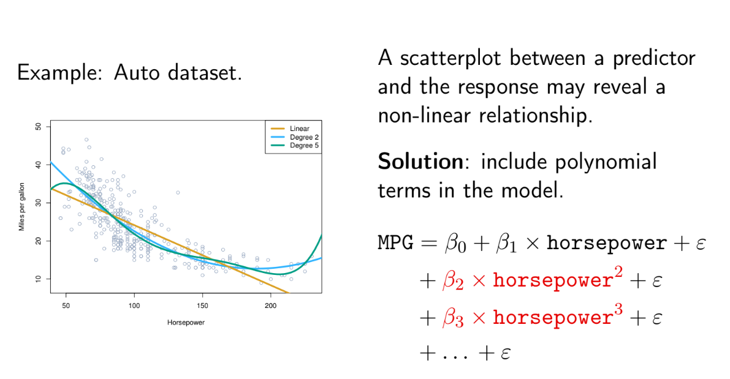

Slide 46
Feature transformation
Discerning the right relationship between your features (independant variables) and your predictions. (dependant variables)

Slide 47
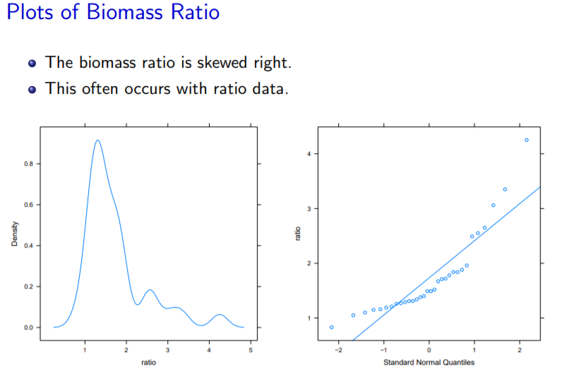

Slide 48
Exercise
Complete the regression notebook.

Slide 49
Classification

Slide 50
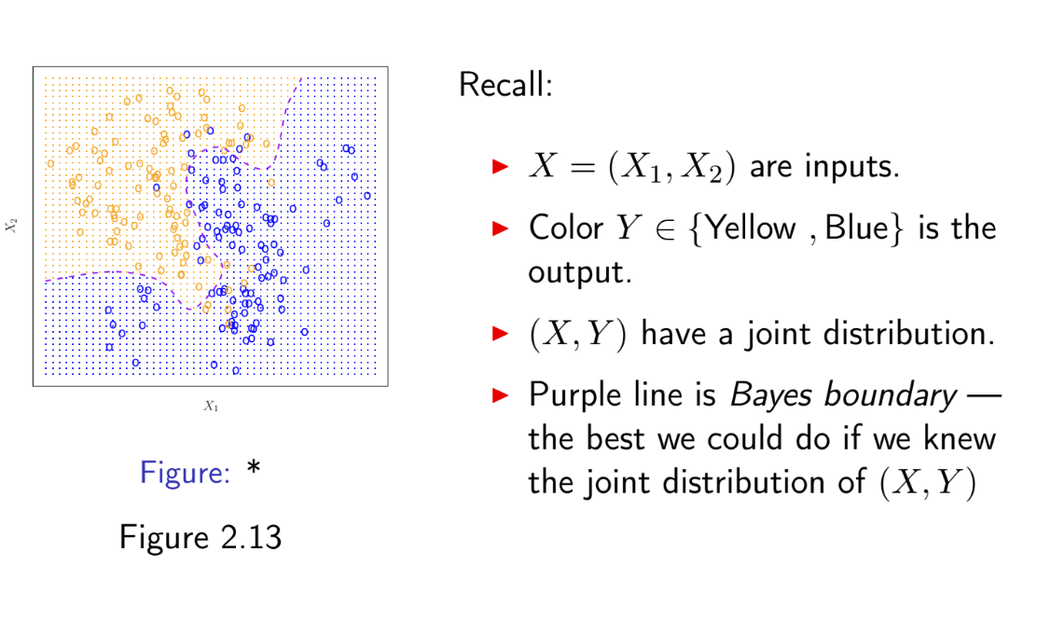

Slide 51
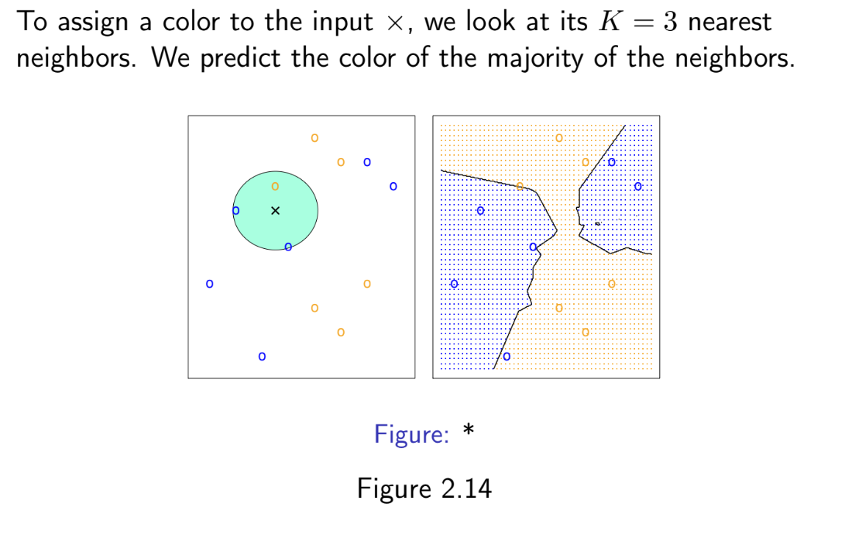
K nearest neighbors

Slide 52
Exercise: Try out a classification Problem

Slide 53
Clustering

Slide 54
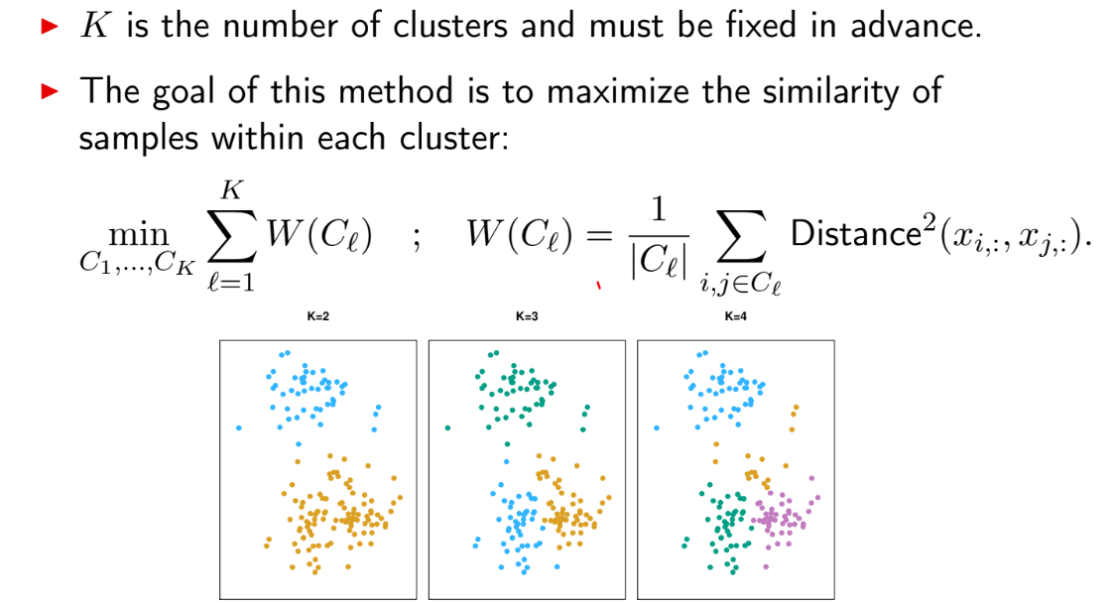
K means clustering

Slide 55
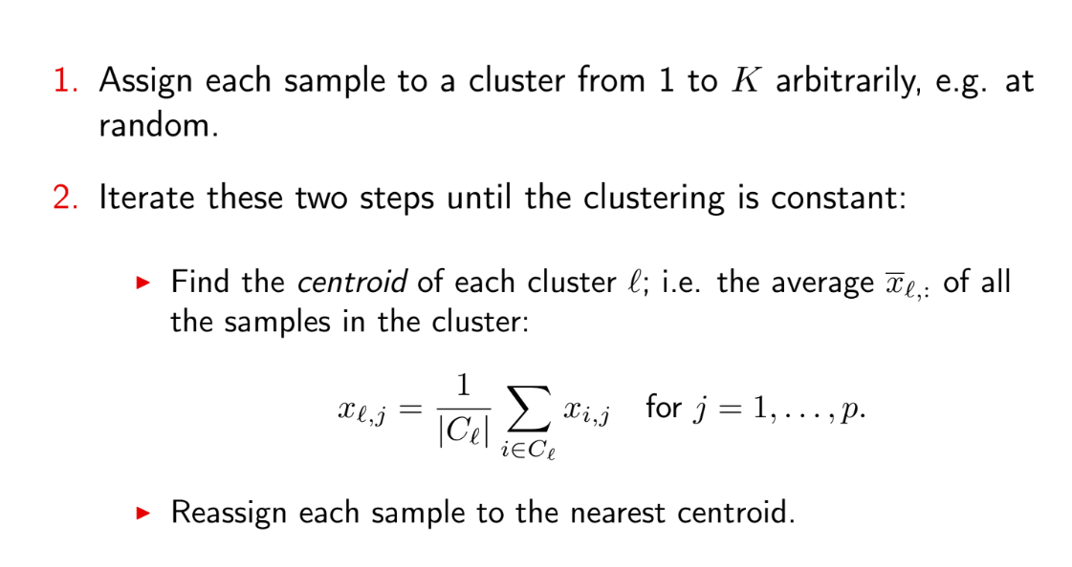

Slide 56
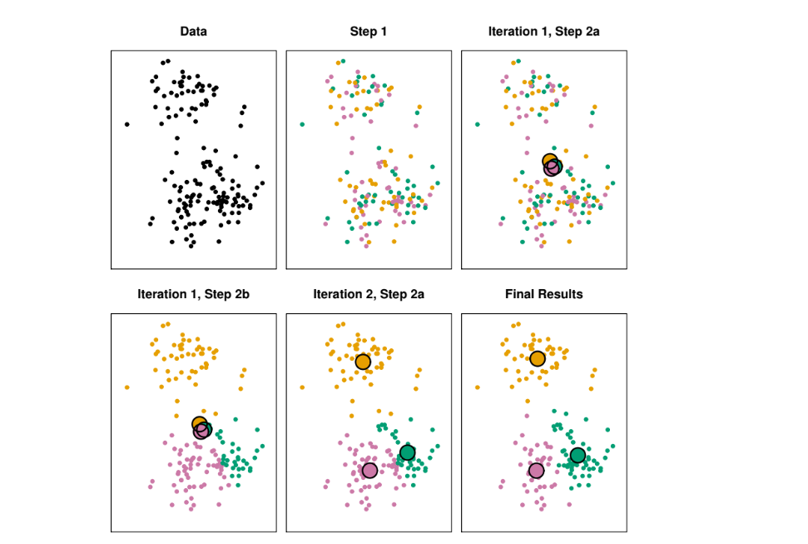

Slide 57
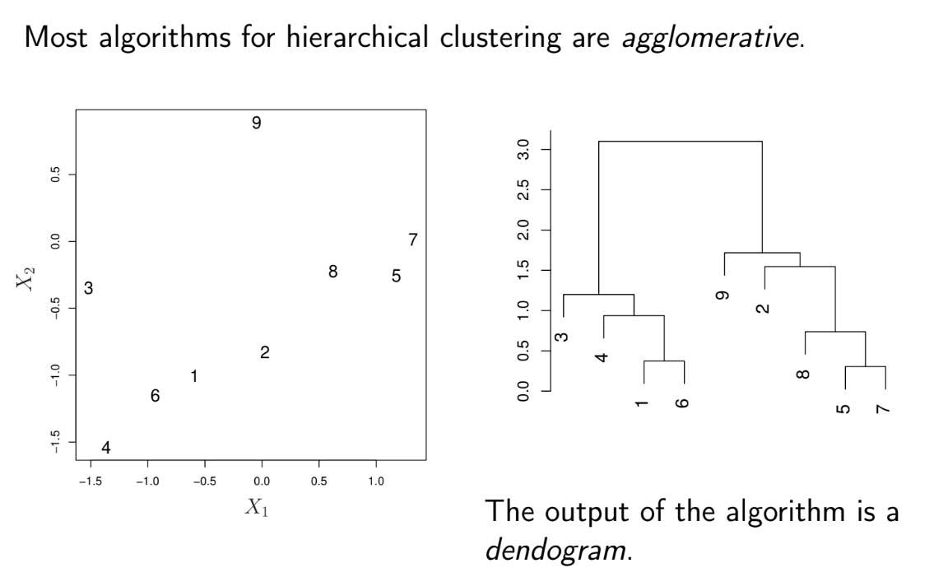

Slide 58
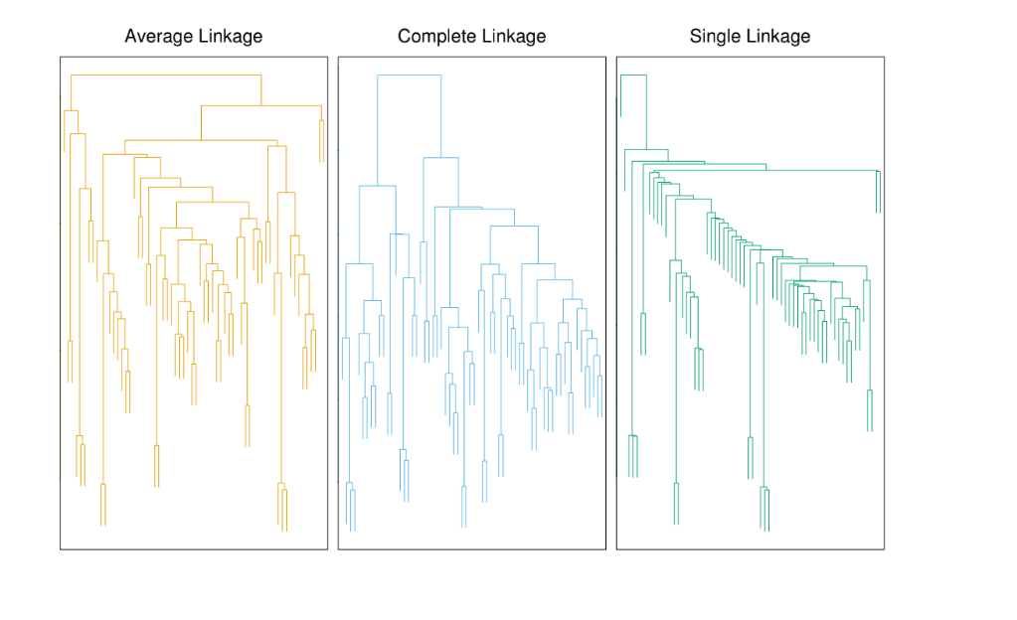

Slide 59
Next,Evaluating your model….
Great work, so you have modelled some real world problem with one of the techniques youve learnt so far? How can we actually use this model to make predictions?
How good is your model? How can we improve it? Are there better techniques to model your data?

Slide 60
Data mining process flow

Slide 61
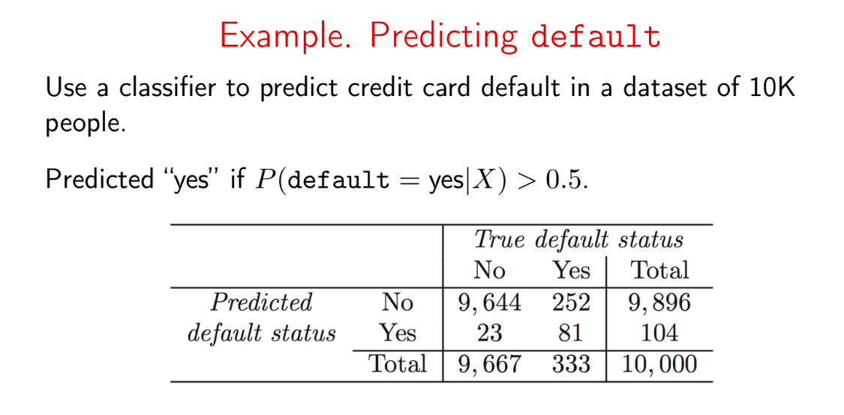
Confusion Matrix Representation

Slide 62
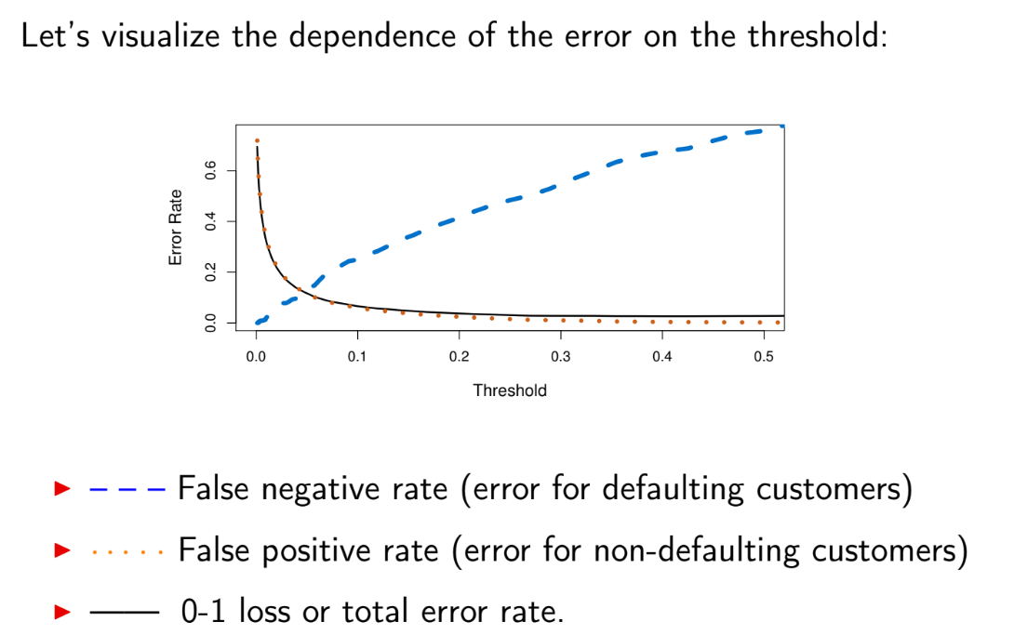

Slide 63
A receiver operating characteristic curve, i.e., ROC curve, is a graphical plot that illustrates the diagnostic ability of a binary classifier system as its discrimination threshold is varied.

Slide 64
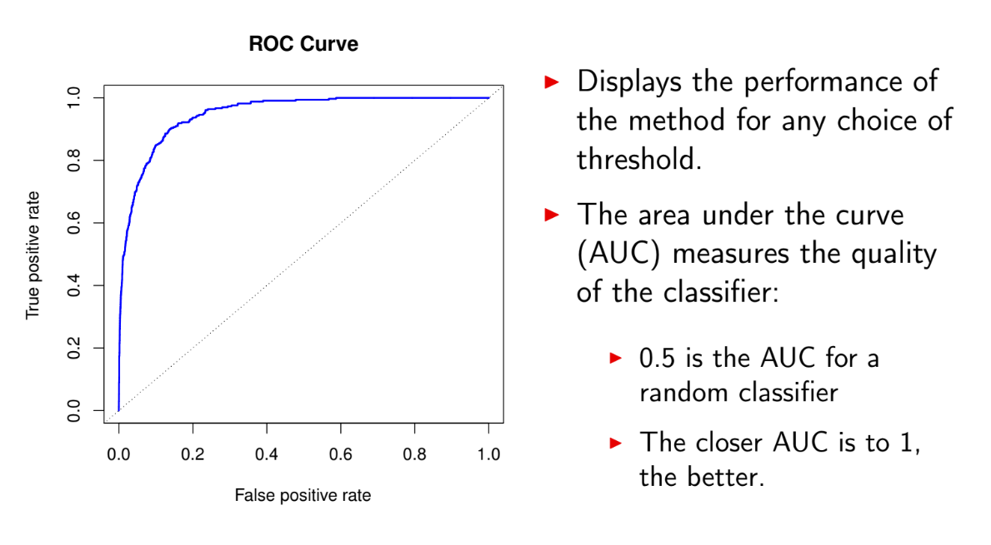

Slide 65
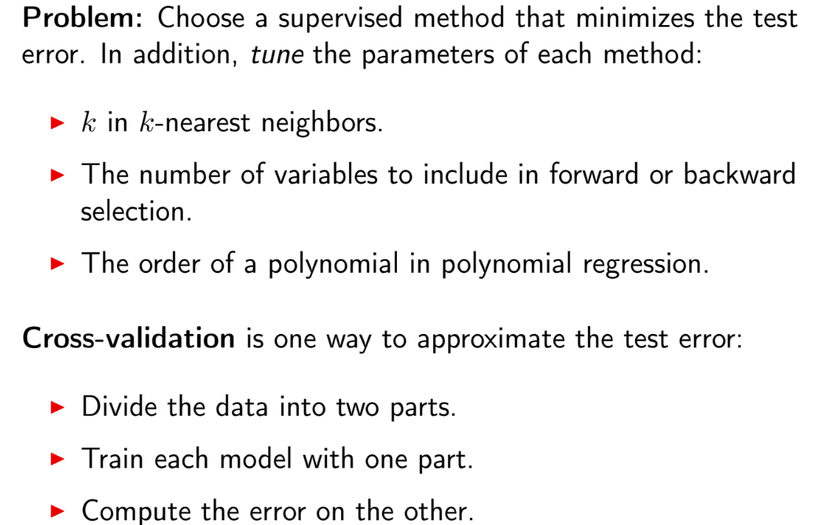

Slide 66
Validation Techniques
(essentially how you split your dataset)
Train-test equal split
Leave one out cross validation
K-Fold Cross Validation

Slide 67
EXAM TIME
Lol jk

Slide 68
Which one of the proposed validation methodologies is correct and which is wrong?

Slide 69
Method 1

Slide 70
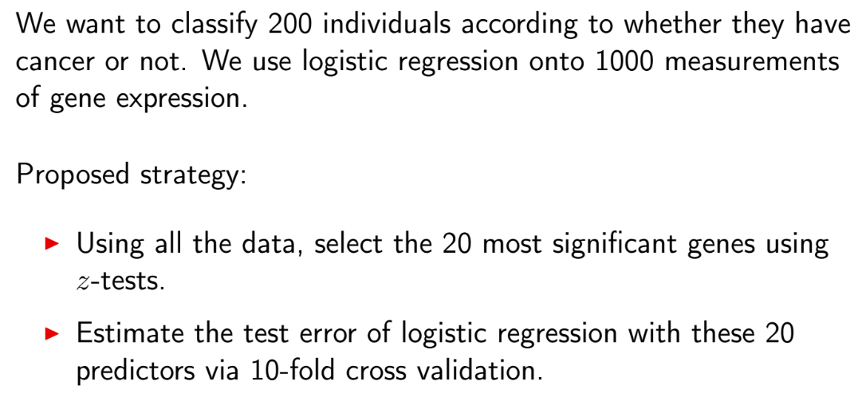

Slide 71
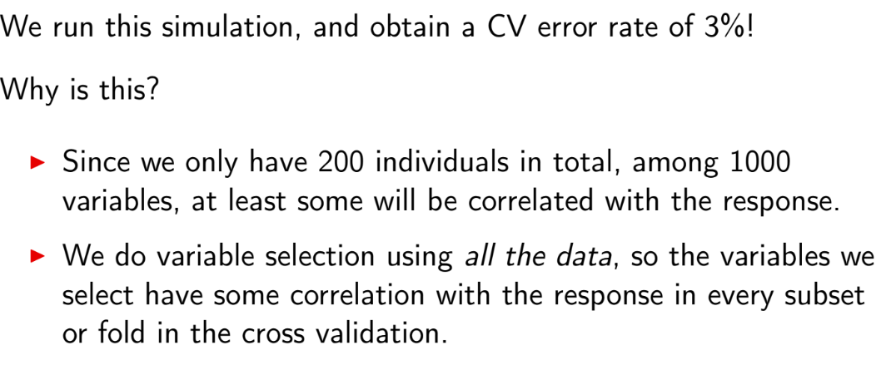

Slide 72
Method 2

Slide 73
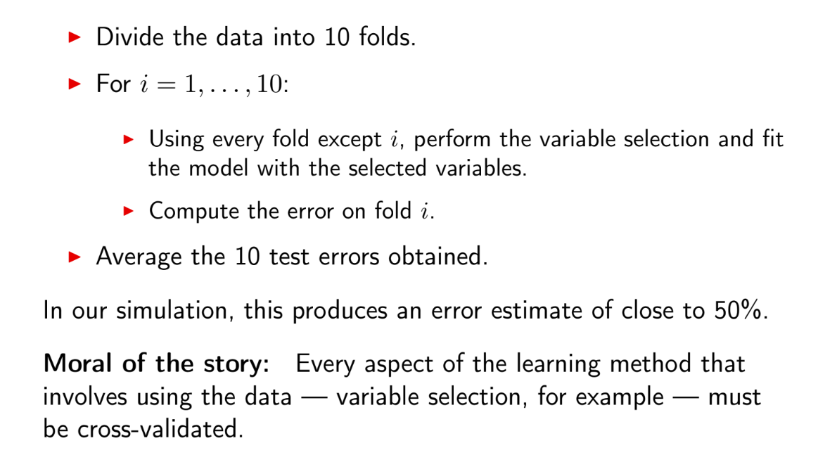

Slide 74
Exercise
Try the validation notebook

Slide 75
Summary

Slide 76
Exercise
Try a data mining algorithm from start to finish on the famous titanic dataset.

